Slide 1


PERSONAL BRANDING
01

Slide 2
PERSONAL BRANDING
02
Table of Contents
Introduction To Personal Branding
Two Methods Of Personal Branding
Engagement Driven
Process Driven
Q&A
Presentation Outline

Slide 3

What is Personal Branding?
03
Personal branding is the conscious and intentional effort to create and influence public perception of an individual by positioning them as an authority in their industry, elevating their credibility, and differentiating themselves from the competition.
(What you think of yourself- (Personal Brand) -What others think of you)

Slide 4

PERSONAL BRANDING
Clarity
The first is clarity. That means you are clear about who you are and what you offer.
Elements
04
Consistency
The second element of a strong personal brand is consistency. Consistency means that you deliver on what you say you will.
Constancy
Constancy translates to making your personal brand visible to the right people who need to know you.

Slide 5
PERSONAL BRANDING
Engagement Driven -
Building personal brand by driving up social media engagements.
05
Process Driven -
Five step process to build a consistent personal brand.

Slide 6

06
Engagement Driven

Slide 7
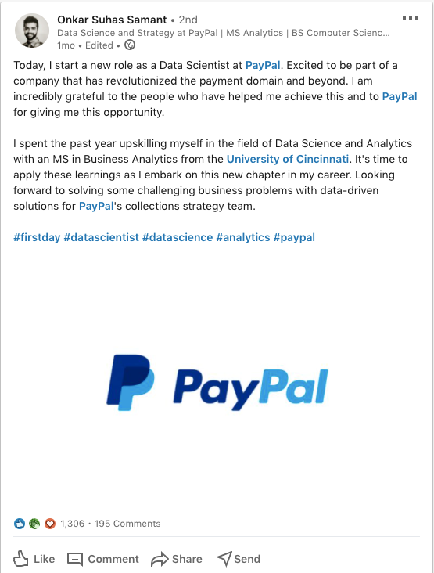
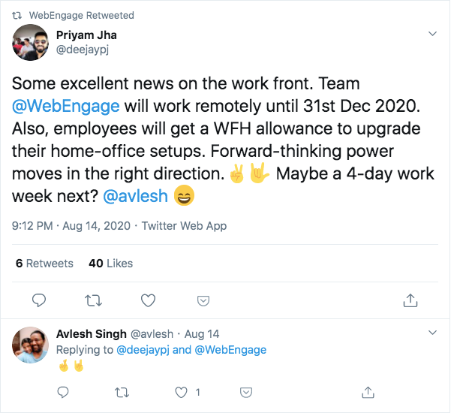
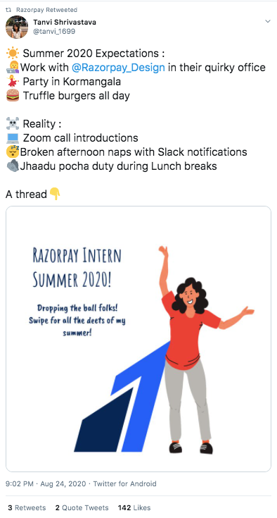
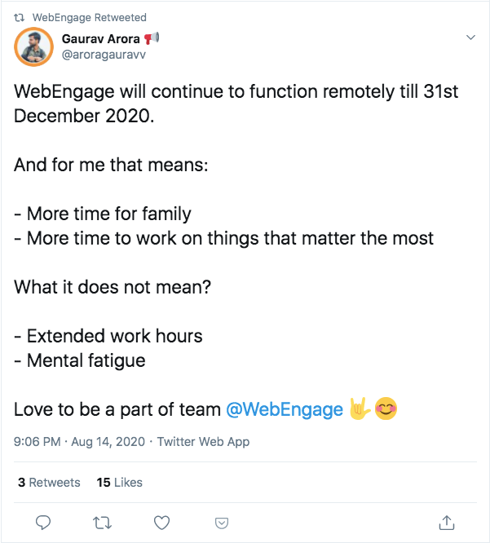

Slide 8
How does it Work?
08
Employee Driven Content
Internal Support
More Company Driven Initiatives
Marketing Team Support

Slide 9

PERSONAL BRANDING
Process
Driven
09
General Perception
Niche
Voice
Content/Calendar
Promotion

Slide 10

PERSONAL BRANDING
10
Better, More Relevant Content
Done to foster brand loyalty

Slide 11
PERSONAL BRANDING
60
Personal
Targets
11
40
Idea is to grow the audience base, MoM, and to set steady achievable goals based on one's social media presence.
20
0
M1
M2
M3
M4
M5

Slide 12
PERSONAL BRANDING
12
Write Your Thoughts, Don't Go After Likes

Slide 13
13
Q & A

